Slide 1
Long Service Leave , Anzac Biscuits & Volunteer Work
David Kraft

Slide 2
Long Service Leave , Anzac Biscuits & Volunteer Work
David Kraft

Slide 3
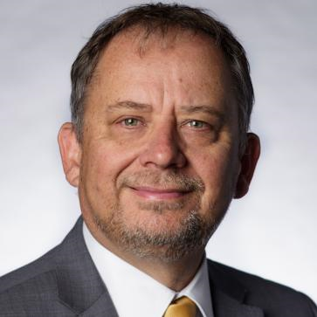
After 35 Years of Working
> 200 days of Long Service Leave Accumulated
(Approx 80 Days still left)
Allan Evans - Come up with a Plan
Notes:
220 days of Long Service Leave 35 Years of Working Come up with a Plan

Slide 4
The Plan
Take 3-5 Weeks Leave a Year
We will include Volunteer Work as Part of Our Holidays
1-2 Weeks Volunteering & the Rest on a Holiday
Notes:
We will include Volunteer Work as Part of Our Holidays
Take 3-5 Weeks Leave
Do 1-2 Weeks Volunteering & Spend the Rest on a holiday
The Plan

Slide 5
The Question
How can we raise over $1,000 to fund our Project?
Notes:
The Question

Slide 6
The Solution
Let’s make Anzac Biscuits
and sell them for Anzac Day
I have an idea !!!
Notes:
How can we raise over $1,000 to fund our Project?
I have an idea - lets make Anzac Biscuits
FUNDRAISING

Slide 7
Advertising
Order Form
Notes:
Advertising
Order Form

Slide 8
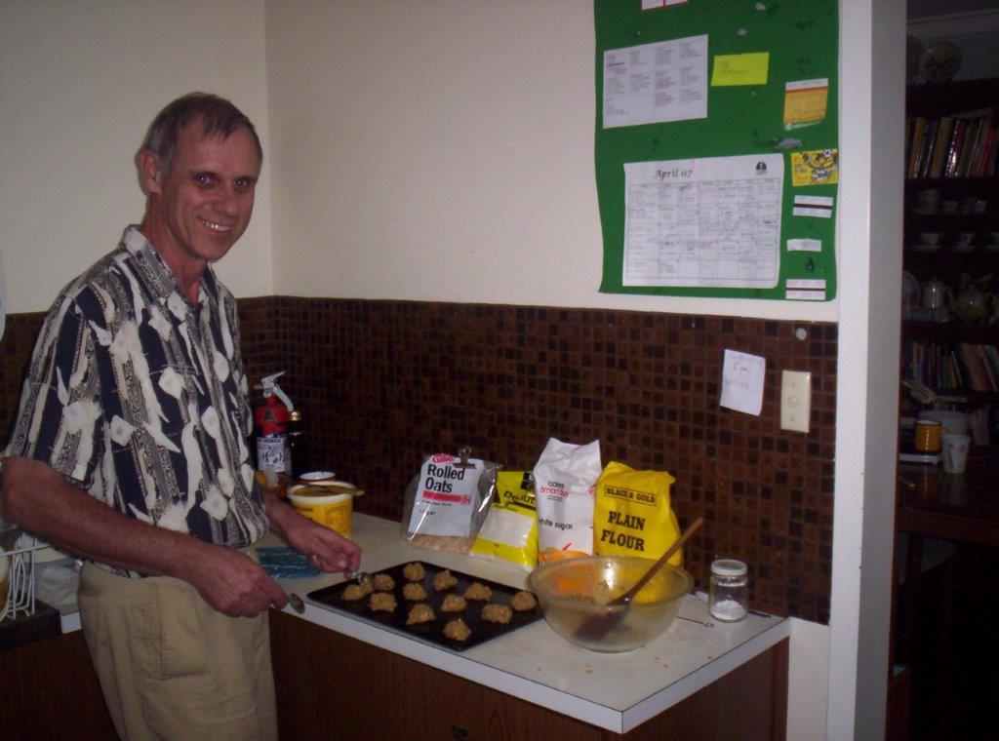
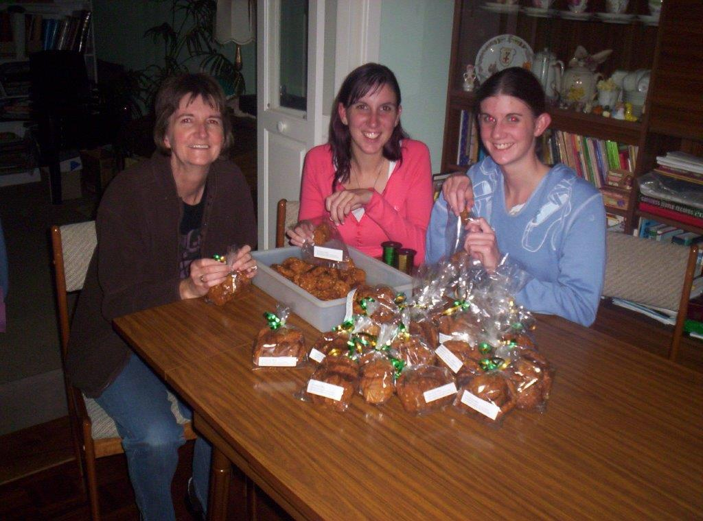
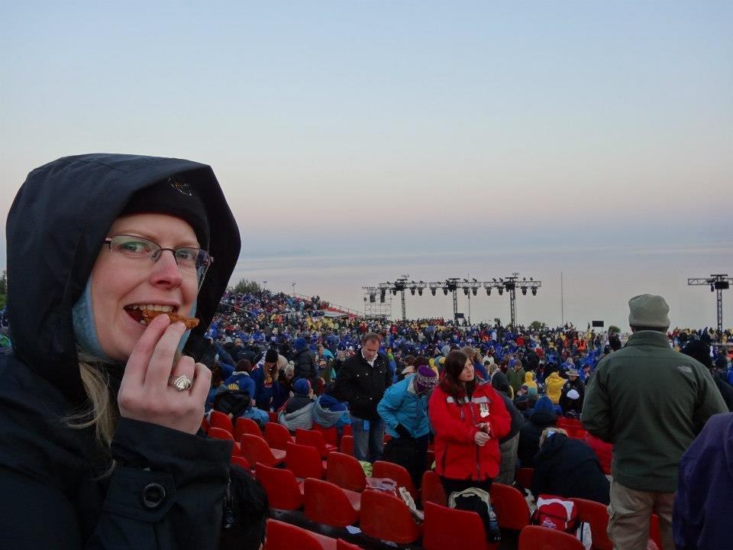
Making & Packing Biscuits
Anzac Cove
Eating Biscuits
Notes:
Anzac Cove

Slide 9
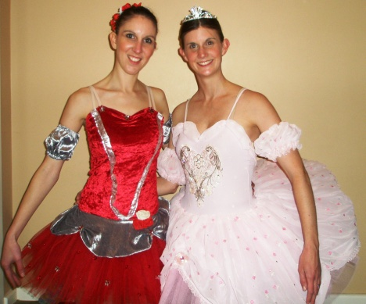
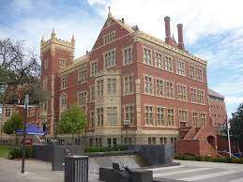
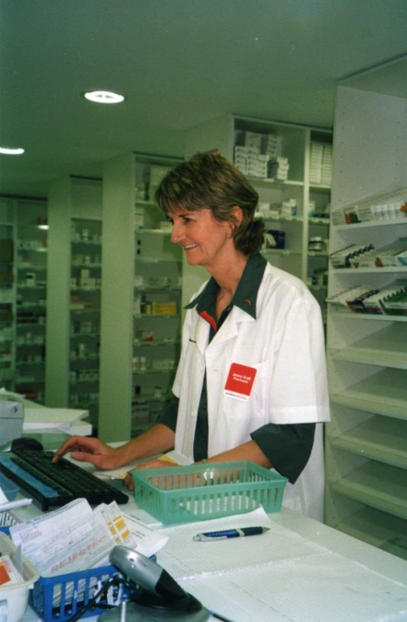
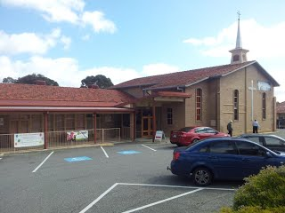
Selling Biscuits
My Work
Girls Ballet School
Jenny’s Work
(Retail Pharmacy)
Our Church
Neighbours

Slide 10
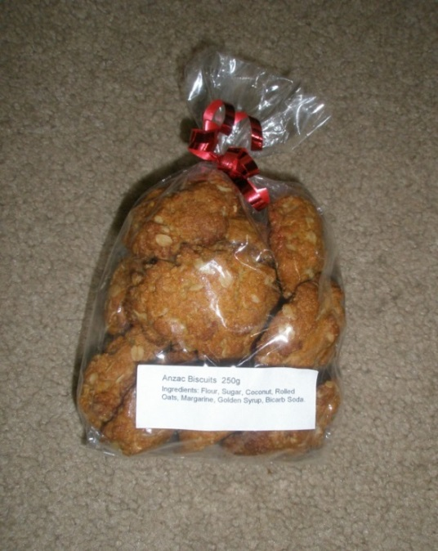
Biscuit Stats
2007 - 222 Packets (12 Biscuits)
64 Sold to Work Colleagues
Overall in 10 Years 3,000 Packets Approx $10,000
Work 1,300 Packets – Approx $3,000
All donations directly support the projects
We covered travel & accom. expenses
Notes:
2007 - 222 Packets of 12 Biscuits 64 Sold to Work Colleagues
10 Years 3,000 Packets Approx $10,000
Work 1,300 Packets – Approx $3,000
Biscuit Sales
All donations directly support the projects
We covered travel & accom expenses

Slide 11
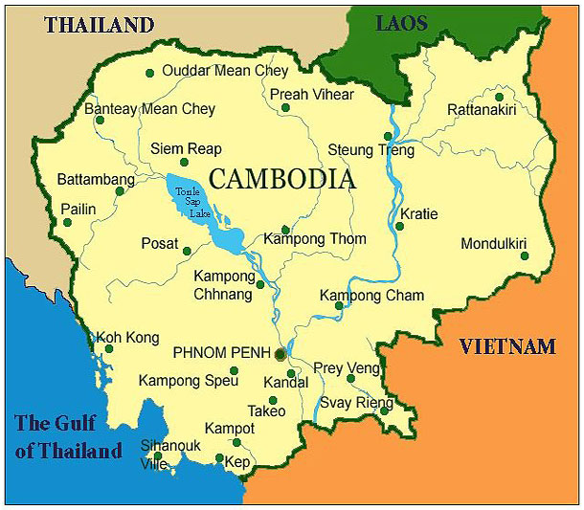
Cambodia - 5 Trips
Phnom Penh (Capital) Siem Reap Preah Vihear
Notes:
Cambodia
Phnom Penh (Capital) Siem Reap Preah Vihear

Slide 12
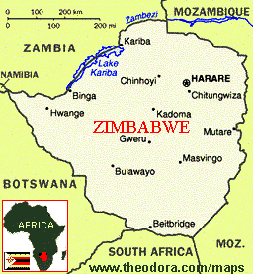
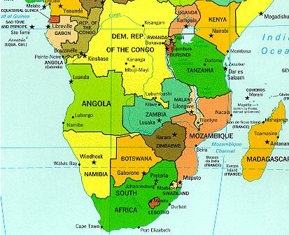
Zimbabwe – 3 Trips
Harare (2) & Chinhoyi (1)
Notes:
Zimbabwe & Chinhoyi

Slide 13
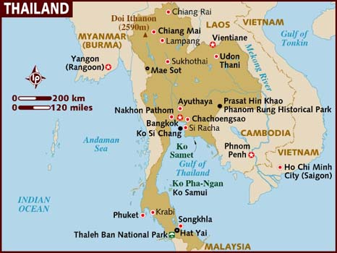
2 Trips – Bangkok, Chiang Mai & Chiang Rai
Notes:
2 Trips

Slide 14
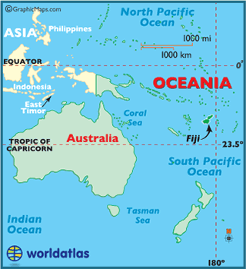
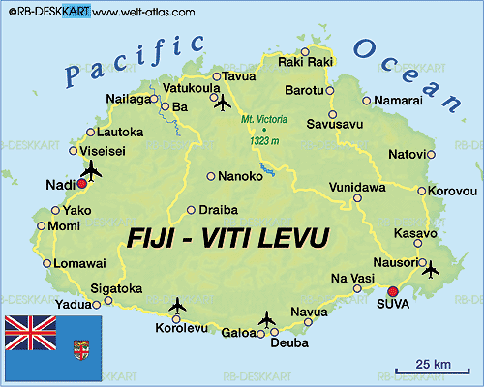
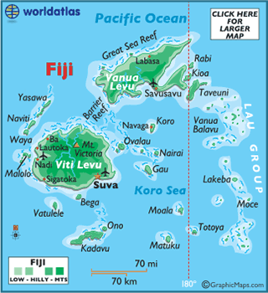
1 Trip –Fiji (Suva)
Suva
Suva
Notes:
Viti Levu Fiji

Slide 15
Christian Based Organisations We Volunteered Through
African Churches Together Serving
Phlas Prei Centre Cambodia
Lois & Roger Whittle
Originally Set up by Asia Focus Aus.
Notes:
Christian based Organisations
Phlas Prei Centre
Lois & Roger Whittle
Originally Set up by Asia Focus
African Churches Together Serving

